Slide 1

PRESIDENCY UNIVERSITY
Bengaluru
Module 3
Advanced machine learning concepts

Slide 2
CONTENT
Nearest Neighbor techniques
  KNN
Cost functions and Optimization technique
  Introduction to gradient descent
  Applications on Linear Regression
Ensemble Learning Algorithms
  Bagging(Random Forest)
  Boosting(Ada Boost)
  XG Boost

Slide 3

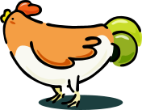




Nearest neighbor techniques
Nearest Neighbor Analysis is a method for classifying cases based on their similarity to other cases.
In machine learning, it was developed as a way to recognize patterns of data without requiring an exact match to any stored patterns, or cases.
If it walks like a duck, quacks like a duck, then it’s probably a duck.
Compute Distance
Test Record
Training Records
Choose k of the “nearest” records

Slide 4
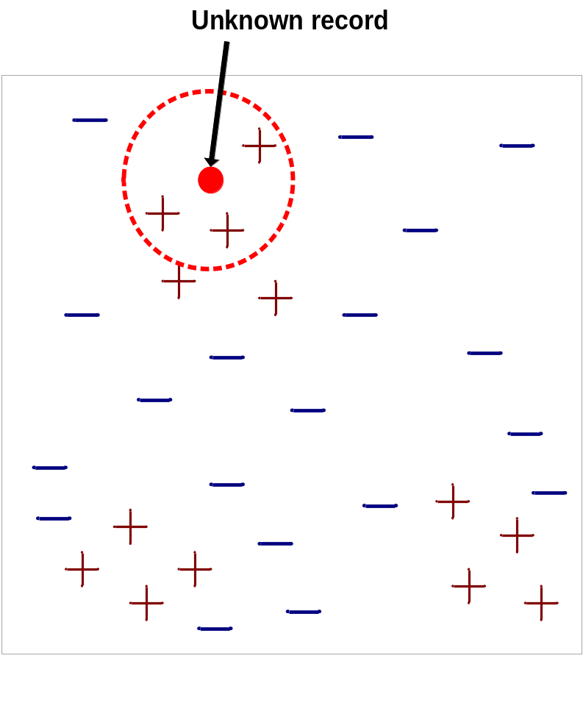
Nearest neighbor techniques
Requires three things
  The set of stored records
  Distance Metric to compute distance between records
  The value of k, the number of nearest neighbors to retrieve
To classify an unknown record:
  Compute distance to other training records
  Identify k nearest neighbors
  Use class labels of nearest neighbors to determine the class label of unknown record (e.g., by taking majority vote)

Slide 5

Nearest neighbor techniques
K-nearest neighbors of a record x are data points that have the k smallest distance to x

Slide 6
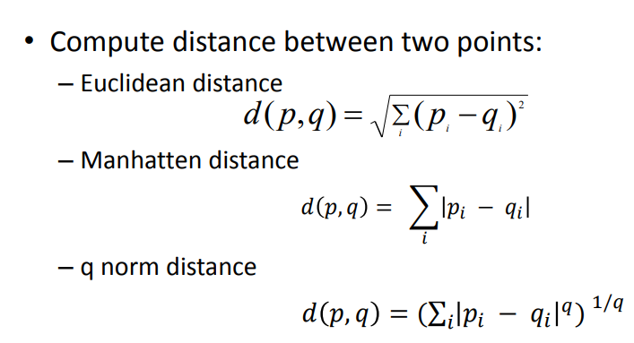
Nearest neighbor techniques

Slide 7
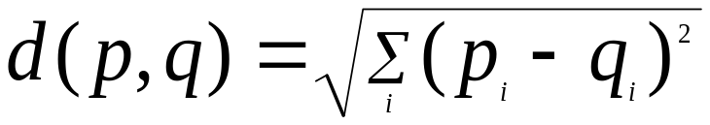
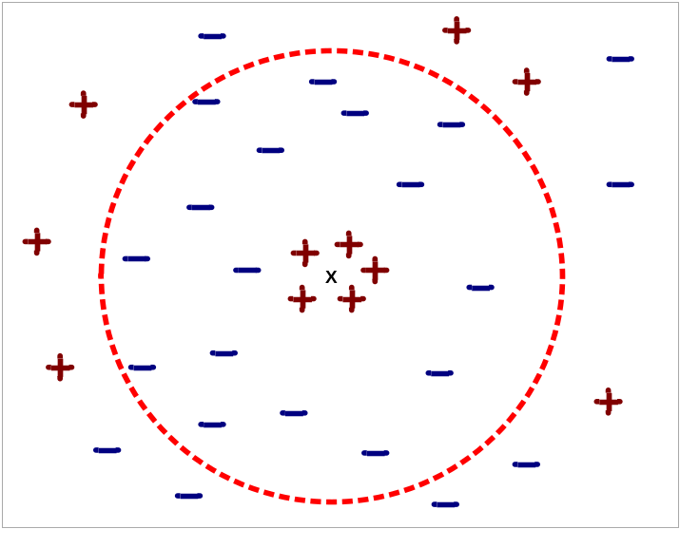
K Nearest neighbor classification
Compute distance between two points:
  Euclidean distance
Determine the class from nearest neighbor list
  take the majority vote of class labels among the k-nearest neighbors
  Weigh the vote according to distance
    weight factor, w = 1/d²
Choosing the value of k:
  If k is too small, susceptible to
  over fitting, due to noise points in
  the training data.
  If k is too large, neighborhood may
  include points from other classes.

Slide 8
K Nearest neighbor classification
Scaling issues
  Attributes may have to be scaled to prevent distance measures from being dominated by one of the attributes
  Example:
    height of a person may vary from 1.5m to 1.8m
    weight of a person may vary from 90lb to 300lb
    income of a person may vary from $10K to $1M
  Solution: Normalize the vectors to unit length

Slide 9
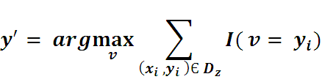
K Nearest neighbor classification
Let k be the no. of nearest neighbors and D be the set of training examples.
for each test example z = (x’, y’) do
2.1 compute d(x’, x), the distance between z and every
example (x,y) Є D.
2.2 Select ⊆ D, the set of k closest training examples to z.
2.3
2.4 end for

Slide 10
K Nearest neighbor classification
Example: The table represents our data set. We have two columns — Brightness and Saturation. Each row in the table has a class of either Red or Blue.
BRIGHTNESS | SATURATION | COLOR
40 | 20 | RED
50 | 50 | BLUE
60 | 90 | BLUE
10 | 25 | RED
70 | 70 | BLUE
60 | 10 | RED
25 | 80 | BLUE
20 | 35 | ?

Slide 11
K Nearest neighbor classification
d1 = √(20 - 40)² + (35 - 20)²
= √400 + 225
= √625
= 25
d2 = √(20 - 50)² + (35 - 50)²
= √900 + 225
= √1125
= 33.54
d3 = √(20 - 60)² + (35 - 90)²
= √1600 + 3025
= √4625
= 68.01
d4 = √(20 - 10)² + (35 - 25)²
= √100 + 100
= √200
= 14.14
d5 = √(20 - 70)² + (35 - 70)²
= √2500 + 1225
= √3725
= 61.03
d6 = √(20 - 60)² + (35 - 10)²
= √1600 + 625
= √2225
= 47.17
d7 = √(20 - 25)² + (35 - 80)²
= √25 + 2025
= √2050
= 45.27
If k= 5, then distance for 1st five nearest value should be noted -> majority Color be red. So, For Brightness -> 20, Saturation -> 35, Color be RED

Slide 12
K Nearest neighbor classification
BRIGHTNESS | SATURATION | COLOR | DISTANCE
40 | 20 | RED | 25
50 | 50 | BLUE | 33.54
60 | 90 | BLUE | 68.01
10 | 25 | RED | 14.14
70 | 70 | BLUE | 61.03
60 | 10 | RED | 47.17
25 | 80 | BLUE | 45.27
20 | 35 | RED

Slide 13
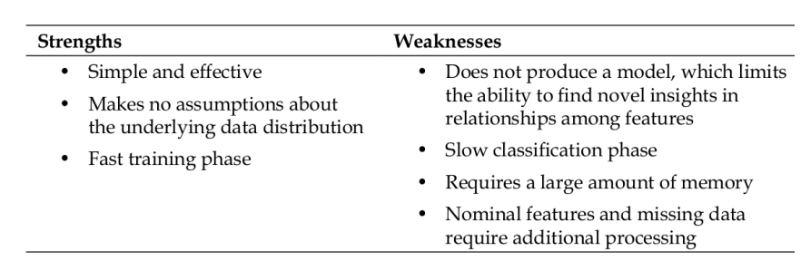
K Nearest neighbor classification

Slide 14
Cost functions and Optimization technique
A Machine Learning model should have a very high level of accuracy in order to perform well with real-world applications. But how to calculate the accuracy of the model, i.e., how good or poor our model will perform in the real world?
In such a case, the Cost function comes into existence.
It is an important machine learning parameter to correctly estimate the model.
A cost function is an important parameter that determines how well a machine learning model performs for a given dataset. It calculates the difference between the expected value and predicted value and represents it as a single real number.
"Cost function is a measure of how wrong the model is in estimating the relationship between X(input) and Y(output) Parameter." A cost function is sometimes also referred to as Loss function.
By minimizing the value of the cost function, we can get the optimal solution.

Slide 15
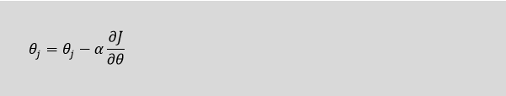
Gradient Descent: Minimizing the cost function
"Gradient Descent is an optimization algorithm which is used for optimizing the cost function or error in the model.“
It enables the models to take the gradient or direction to reduce the errors by reaching to least possible error.
Gradient descent is an iterative process where the model gradually converges towards a minimum value, and if the model iterates further than this point, it produces little or zero changes in the loss. This point is known as convergence, and at this point, the error is least, and the cost function is optimized.
In the gradient descent equation, alpha is known as the learning rate.

Slide 16
Gradient Descent: Minimizing the cost function
Types of Cost Function
Cost functions can be of various types depending on the problem.
Regression Cost Function: Regression models are used to make a prediction for the continuous variables such as the price of houses, weather prediction, loan predictions, etc. When a cost function is used with Regression, it is known as the "Regression Cost Function.“
  Error= Actual Output-Predicted output
  Three commonly used Regression cost functions
  1. Means Error
  2. Mean Squared Error(MSE)
  3. Mean Absolute Error(MAE)
Binary Classification cost Functions: Classification models are used to make predictions of categorical variables, such as predictions for 0 or 1, Cat or dog, etc. The cost function used in the classification problem is known as the Classification cost function.
Multi-class Classification Cost Function: A multi-class classification cost function is used in the classification problems for which instances are allocated to one of more than two classes.

Slide 17
Gradient Descent: APPLICATIONS ON LINEAR REGRESSION
Gradient Descent is an algorithm that finds the best-fit line for a given training dataset in a smaller number of iterations.
A Linear Regression model converging to optimum solution using Gradient Descent.
Gradient Descent is used for multiple linear regression as an iterative algorithm use in loss function to find the global minima. The loss can be any differential loss function.
Real time applications: Calculate the gradients of slopes in and around school, like staircases and ramps.

Slide 18
ENSEMBLE LEARNING ALGORITHM
Ensemble means combining multiple models.
Predict class label of previously unseen records by aggregating predictions made by multiple classifiers
Improves the classification accuracy
Predicted output of the base classifiers is combined by majority voting
Build different experts and let them vote.
Build many models and combine them.
Only through averaging do we get at the truth!
It’s too hard (impossible?) to build a single model that works best
Two types of approaches:
  Models that don’t use randomness
  Models that incorporate randomness

Slide 19
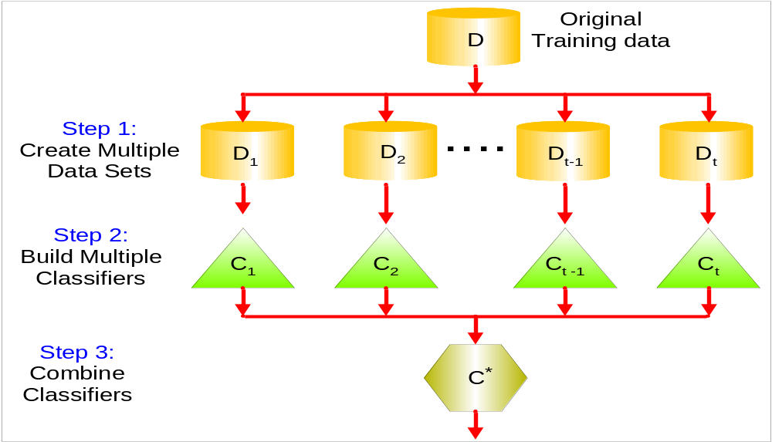
ENSEMBLE LEARNING ALGORITHM

Slide 20
BAGGING(BOOTSTRAP AGGREGATION)
Main Assumption:
  Combining many unstable predictors to produce a ensemble (stable) predictor.
  Unstable Predictor: small changes in training data produce large changes in the model.
    e.g. Neural Nets, trees
    Stable: SVM (sometimes), Nearest Neighbor.
Hypothesis Space
  Variable size (nonparametric):
    Can model any function if you use an appropriate predictor (e.g. trees)

Slide 21
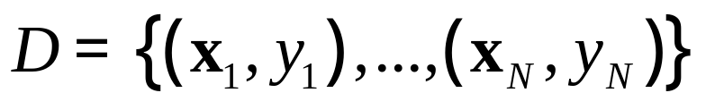




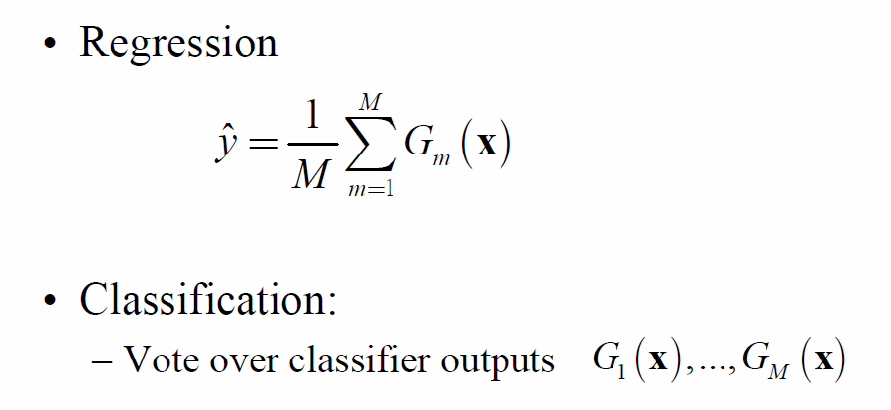
BAGGING ALGORITHM
Given data:
For
Obtain bootstrap sample from the training data
Build a model from bootstrap data

Slide 22
BAGGING – RANDOM FOREST ALGORITHM
Random Forest Algorithm widespread popularity stems from its user-friendly nature and adaptability, enabling it to tackle both classification and regression problems effectively.
Random Forest Algorithm is that it can handle the data set containing continuous variables, as in the case of regression, and categorical variables, as in the case of classification. It performs better for classification and regression tasks.
Real Time application: A student named X wants to choose a course after his 10+2, and he is confused about the choice of course based on his skill set. So he decides to consult various people like his cousins, teachers, parents, degree students, and working people. He asks them varied questions like why he should choose, job opportunities with that course, course fee, etc. Finally, after consulting various people about the course he decides to take the course suggested by most people.

Slide 23
BAGGING – RANDOM FOREST ALGORITHM
Steps Involved in Random Forest Algorithm
Step 1: In the Random forest model, a subset of data points and a subset of features is selected for constructing each decision tree. Simply put, n random records and m features are taken from the data set having k number of records.
Step 2: Individual decision trees are constructed for each sample.
Step 3: Each decision tree will generate an output.
Step 4: Final output is considered based on Majority Voting or Averaging for Classification and regression, respectively.
Example: Consider the fruit basket as the data as shown in the figure below. Now n number of samples are taken from the fruit basket, and an individual decision tree is constructed for each sample. Each decision tree will generate an output, as shown in the figure. The final output is considered based on majority voting. In the below figure, you can see that the majority decision tree gives output as an apple when compared to a banana, so the final output is taken as an apple.

Slide 24
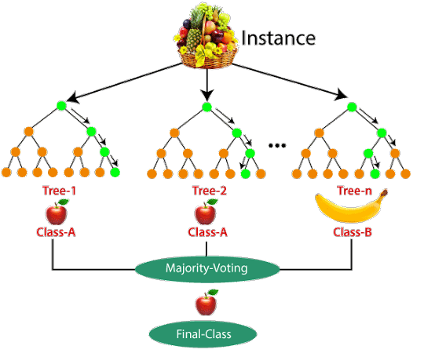
BAGGING – RANDOM FOREST ALGORITHM

Slide 25
ADVANTAGES & DISADVANTAGES
ADVANTAGES
It reduces over fitting in decision trees and helps to improve the accuracy
It is flexible to both classification and regression problems
It works well with both categorical and continuous values
It automates missing values present in the data
Normalizing of data is not required as it uses a rule-based approach.
DISADVANTAGES
It requires much computational power as well as resources as it builds numerous trees to combine their outputs.
It also requires much time for training as it combines a lot of decision trees to determine the class.
Due to the ensemble of decision trees, it also suffers interpretability and fails to determine the significance of each variable.

Slide 26
BOOSTING
Boosting is an ensemble modeling technique that attempts to build a strong classifier from the number of weak classifiers.
It is done by building a model by using weak models in series. Firstly, a model is built from the training data. Then the second model is built which tries to correct the errors present in the first model.
This procedure is continued and models are added until either the complete training data set is predicted correctly or the maximum number of models are added.

Slide 27
TRAINING THE BOOSTING MODEL
Initialise the dataset and assign equal weight to each of the data point.
Provide this as input to the model and identify the wrongly classified data points.
Increase the weight of the wrongly classified data points.
if (got required results)
Goto step 5
else
Goto step 2
End

Slide 28
ADVANTAGES & DISADVANTAGES
Improved Accuracy – Boosting can improve the accuracy of the model by combining several weak models’ accuracies and averaging them for regression or voting over them for classification to increase the accuracy of the final model.
Robustness to Over fitting – Boosting can reduce the risk of over fitting by reweighting the inputs that are classified wrongly.
Better handling of imbalanced data – Boosting can handle the imbalance data by focusing more on the data points that are misclassified
Better Interpretability – Boosting can increase the interpretability of the model by breaking the model decision process into multiple processes.
DISADVANTAGES
Boosting Algorithms are vulnerable to the outliers
It is difficult to use boosting algorithms for Real-Time applications.
It is computationally expensive for large datasets

Slide 29
ADA BOOST
AdaBoost is a boosting algorithm that also works on the principle of the stagewise addition method where multiple weak learners are used for getting strong learners.
The value of the alpha parameter, in this case, will be indirectly proportional to the error of the weak learner, Unlike Gradient Boosting in XGBoost, the alpha parameter calculated is related to the errors of the weak learner, here the value of the alpha parameter will be indirectly proportional to the error of the weak learner.
ADVANTAGES: The flexible AdaBoost can also be used for accuracy improvement of weak classifiers and cases in image/text classification. DISADVANTAGES: AdaBoost uses a progressively learning boosting technique.

Slide 30
XGBOOST
In addition to the gradient boosting technique, XG Boost is another boosting machine learning approach.
The full name of the XG Boost algorithm is the eXtreme Gradient Boosting algorithm, which is an extreme variation of the previous gradient boosting technique.
The key distinction between XG Boost and Gradient Boosting is that XGBoost applies a regularization approach.
It is a regularized version of the current gradient-boosting technique. Because of this, XGBoost outperforms a standard gradient boosting method, which explains why it is also faster than that.
Additionally, it works better when the dataset contains both numerical and categorical variables.
ADVANTAGES : It makes it easy to scale up on multicore machines or clusters.
DISADVANTAGES: It can over-fit the data, especially if the trees are too deep with noisy data.

Slide 31
Thank you

